Slide 1
3D Printing by
Selective Laser Sintering
Group 12
Luis Carrillo Electrical Engineer
Michael McMahon Photonic Engineer
Michael Rogatinsky Computer Engineer
Daniel Valledor Electrical Engineer
Group 12
3D Printing by Selective Laser Sintering
Notes:
Hello everyone and welcome to Group 12’s final project presentation.
Our project is 3D printing by selective laser sintering.
The members of group 12 are Luis Carrillo, Michael McMahon, Michael Rogatinsky, and Daniel Valledor.

Slide 2
What is Selective Laser Sintering?
Selective Laser Sintering (SLS)
3D manufacturing technology
Uses thermal energy from laser to sinter (fuse) particles together
The Process
Laser scans over powder bed and sinters
After scanning one layer, plate drops
Powder delivery plate rises
Powder is pushed over lowered build plate
1-4 repeat until 3D parts are printed
Group 12
3D Printing by Selective Laser Sintering
Notes:
For those unaware, Selective Laser Sintering is a 3D manufacturing technology which uses a focused laser to deliver thermal energy via absorption to a bed of powder.
The thermal energy fuses the powder particles together.
This fusion process is called sintering and is similar to melting.
To create 3D objects by sintering, a laser serially scans a pattern onto a bed of powder.
The powder is located on top of a build plate.
Once the laser is finished scanning, the build plate lowers, which rises the powder reservoir plate.
Then, a sweeping mechanism transfers powder from the reservoir to the build plate.
The laser scans the new layer of powder, and the process repeats until an object is formed.

Slide 3
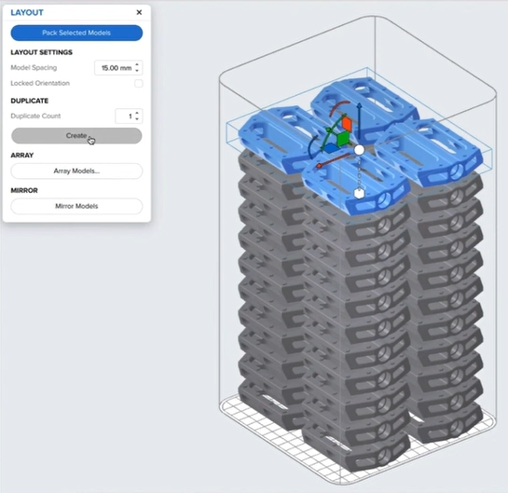
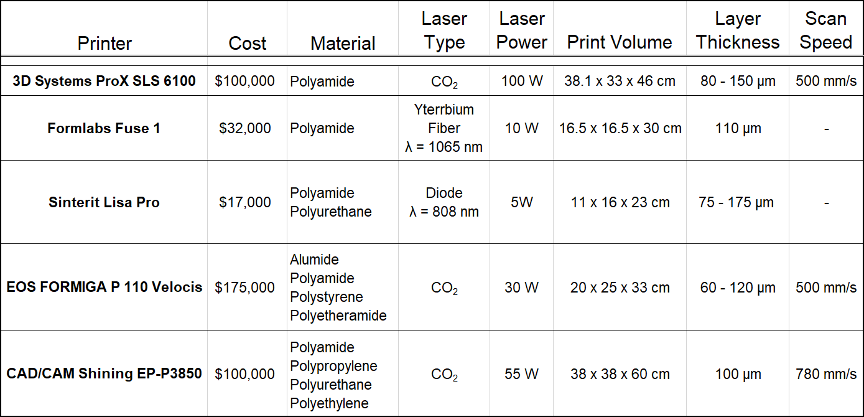
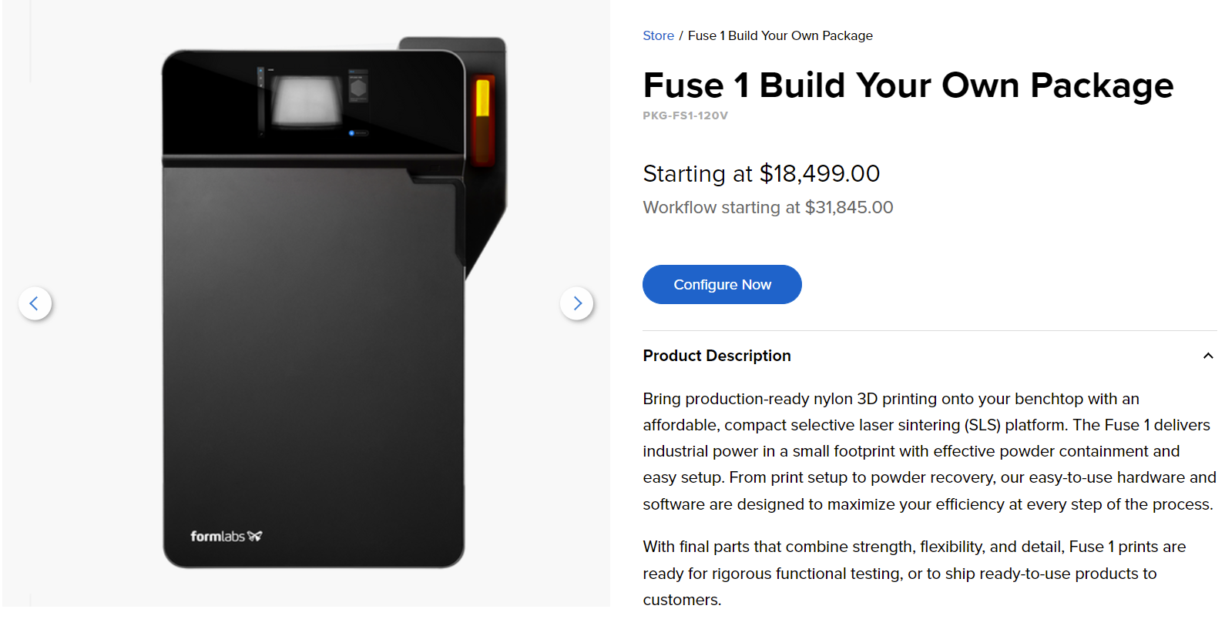
Project Motivation
Why choose SLS?
Higher resolution than traditional FDM printers
Prints are self supporting
Wider material selection
What are the motivations?
Market needs cheaper consumer 3D printers
No SLS kit availability
Currently not directed towards hobbyists
Group 12
3D Printing by Selective Laser Sintering
Notes:
The motivation to create an SLS printer is two-fold.
First, SLS printers have much higher performance than traditional FDM printers.
SLS printers exhibit fantastic resolution that is limited only by particle size or the spot size of the laser.
The process is also inherently self supporting, as the sintered parts use the powder around them as supports.
SLS printers also can sinter many types of materials, such as carbon fiber, glass, and other ceramics,
Second, our motivation comes from the fact that the market is not yet on a hobbyist or enthusiast level.
The cheapest SLS printers still cost nearly $20,000.

Slide 4
Goals and Objectives
Create a powder delivery system with smooth, reproducible movements
Create an X-Y scanning system with high accuracy, speed, and low mechanical jitter
Create a laser module and driver with stable power output
Develop a material composition with consistent sintering characteristics
Create a power supply system for all motors and powered subsystems
Implement firmware to control the X-Y scanning system, laser output, powder delivery, and safety functions
Create a safe enclosure
Electronics
Mechanical Assembly
Software
Laser and Material
SLS
Printer
Group 12
3D Printing by Selective Laser Sintering
Notes:
To create the SLS printer, we will need to create a smooth powder delivery system, an accurate x-y scanning system, a stable laser module and driver, a power supply, have robust firmware, all while ensuring the safety of its users.
Due to the high cost of SLS powders, we will also develop our own.

Slide 5
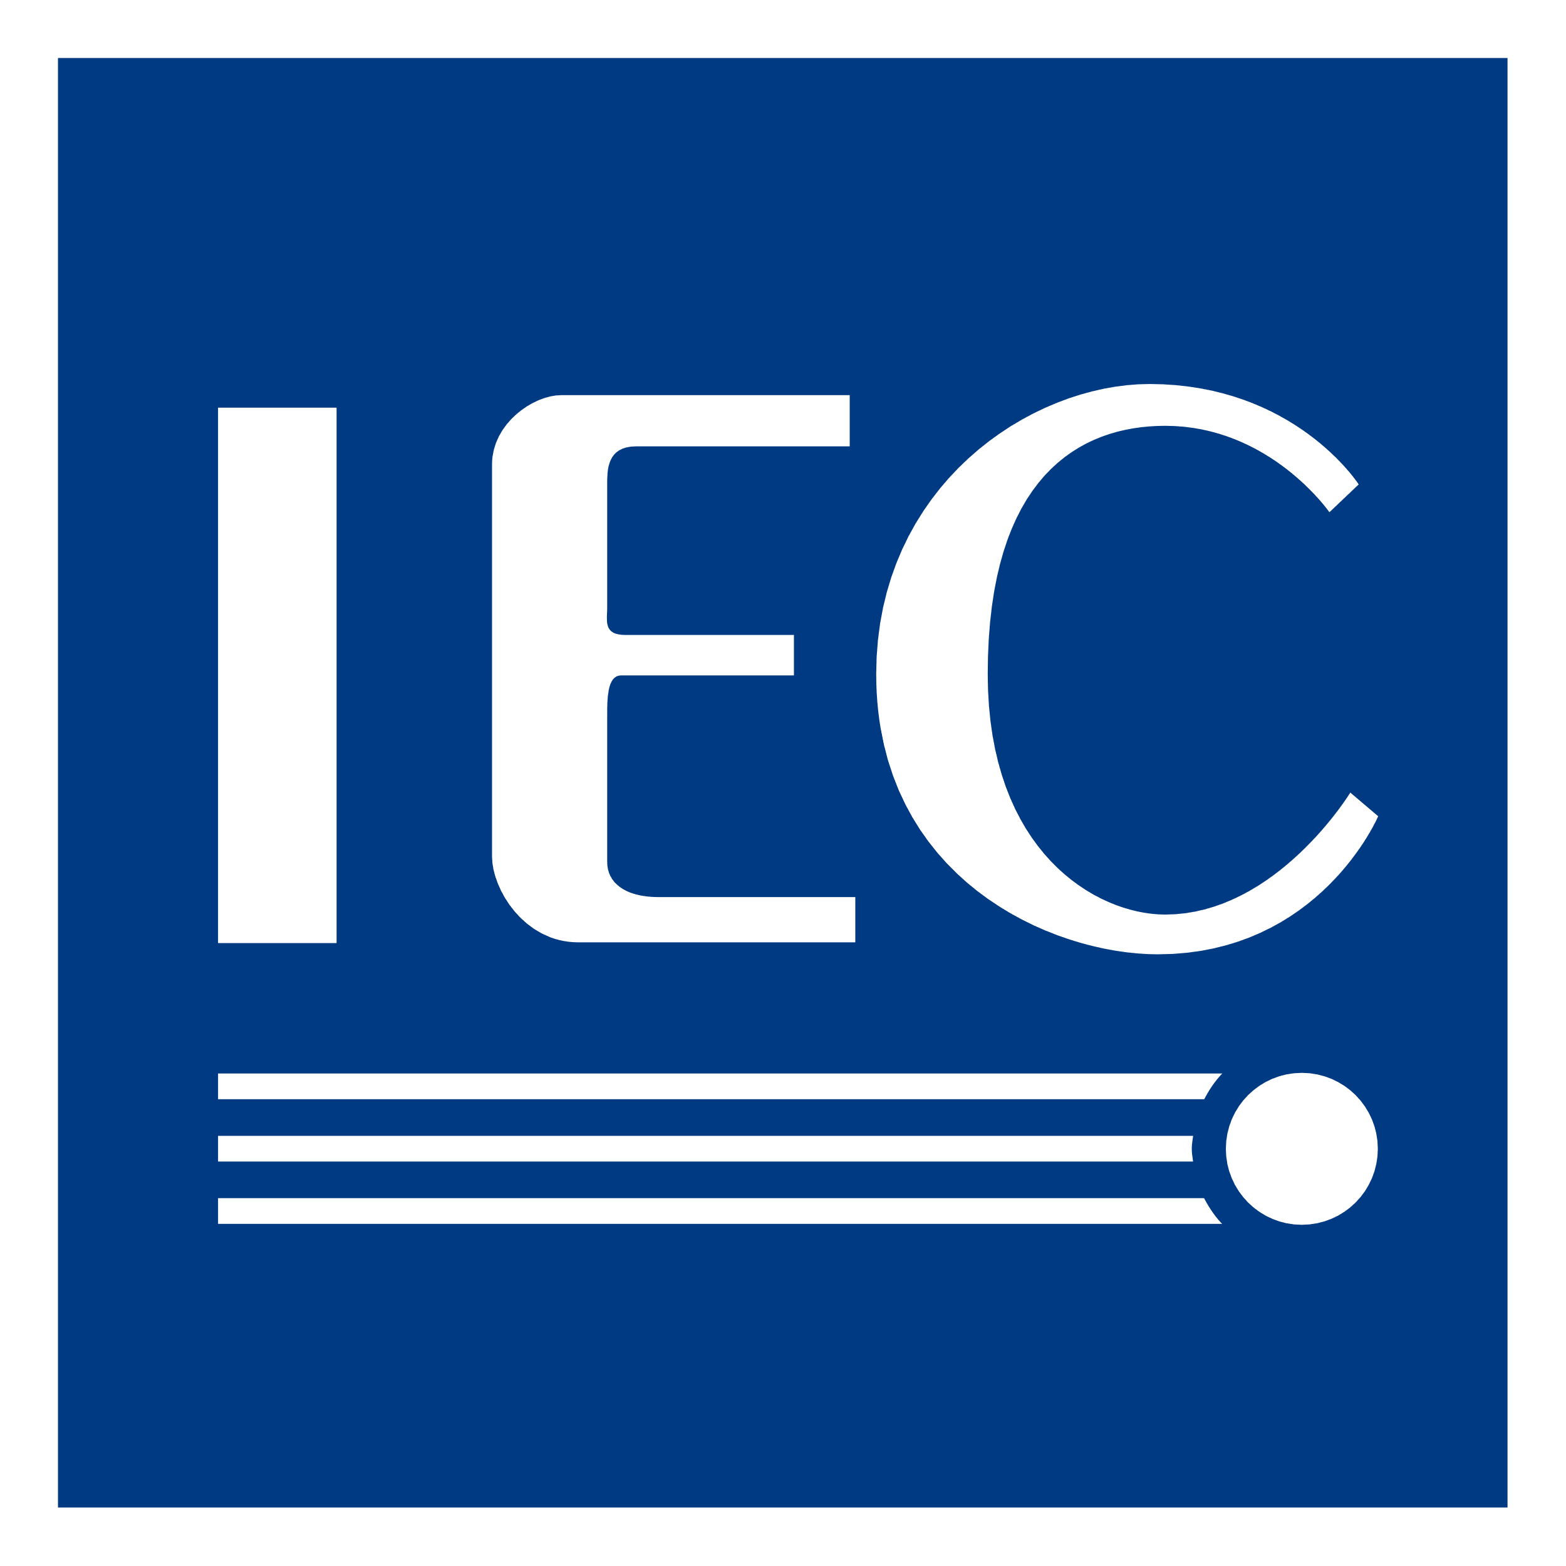
Standards
ANSI Z136.1 Safe Use of Lasers
IEC 60825-1 Safety of Laser Products
ISO 27547-1 Preparation of test specimens of thermoplastics, laser sintering of test specimens
ISO/ASTM 52911-2 Design of Laser-based powder bed fusion of polymers
ISO/ASTM AWI 52938-1 Environment, Health, and Safety requirements for PBF-LB machines
USB 1.1 Proper use of connection type for digital communications
Group 12
3D Printing by Selective Laser Sintering
Notes:
To guide our design, we have referenced a number of standards, a few of which can be seen here.

Slide 6
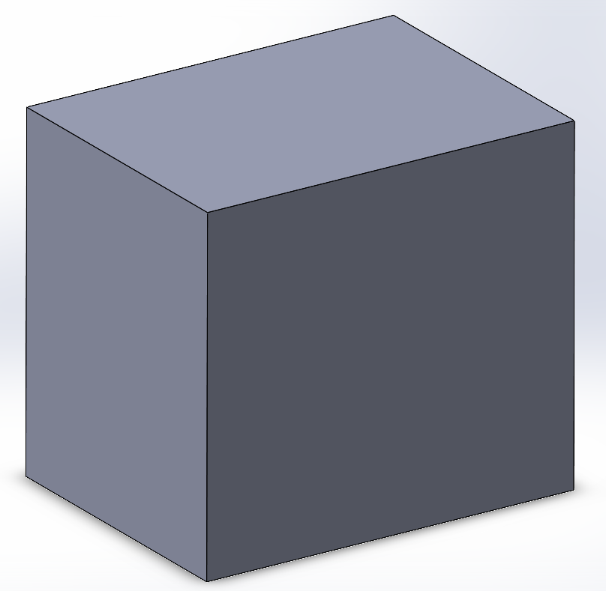
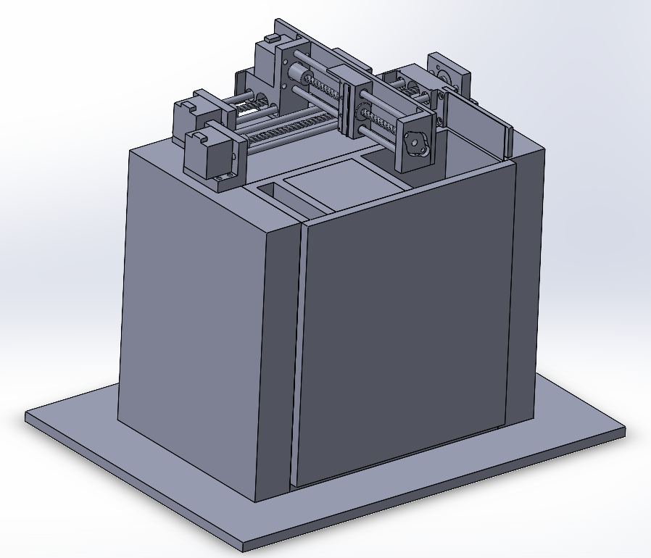
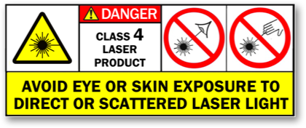
Health and Safety
Some considerations for safe operations include:
NEMA standards for power cords
Ensure closed wiring
Proper heat dissipation of components
ANSI standards for safe use of lasers
Emergency kill switch
Contact switch for enclosure
Top cover of the enclosure
Full printer assembly
Group 12
3D Printing by Selective Laser Sintering
Notes:
The safe operation of the SLS printer is crucial.
We will follow standards for safe operation, as well as implement engineering controls in case of accidents.
Our SLS printer will have a removable lid which will serve as a shield from high power laser light as well as a shield from moving mechanical parts.

Slide 7
Specifications and Constraints
Print Bed Area
Laser Diode Output Power
X-Y Build Area
Laser Diode Wavelength
Print Height
Beam Focal Length
Power Source
120V Wall Power
X-Y Scanning Speed
User Interface
Local Host Server
Material Type
Sugar, Polyamides, TPE, TPU
Motor Torque
Laser Spot Size
Constraints: Time, Budget and Part Manufacturing
Group 12
3D Printing by Selective Laser Sintering
Notes:
Below are the specifications of our SLS printer, such as build volume size, laser output power, and scanning speed.

Slide 8
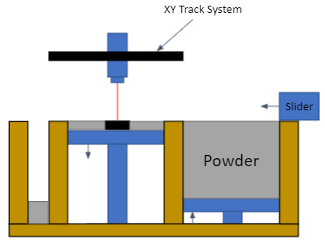
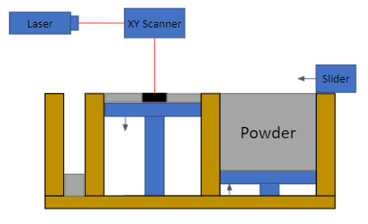
Conceptual 2D Diagram
XY Scanner Concept
XY Track Concept
Group 12
3D Printing by Selective Laser Sintering
Notes:
When considering the SLS structure, there are two types of laser systems.

Slide 9
Hardware Block Diagram
Power
AC-DC Converter
X-Axis Motor
Signal
Light
Mechanical
9 Volt Regulators
9 V
Stepper Motor Drivers
Y-Axis Motor
Power
Controller
Mechanical
XY Track
6 Volt Regulator
6 V
Sweeper Motor
Sweeper
12 V
5 Volt Regulator
Laser Driver
Laser Module
Build Reservoir Motor
Build Plate
Powder
5 V
MCU
Powder Reservoir Motor
Powder Plate
5 V
Computer
Group 12
3D Printing by Selective Laser Sintering

Slide 10
Work Distribution
 | Mechanical System | Power Module | MCU Module | Laser Driver Module | Stepper Motor Driver Module | Firmware | Laser Module | Material
Primary | Daniel | Luis | Luis | Daniel | Daniel | Michael R. | Michael M. | Michael M.
Secondary | Michael R. |  | Michael R. | Michael M. | Luis |  |  | Daniel
Group 12
3D Printing by Selective Laser Sintering

Slide 11
Laser and Material Design
Group 12
3D Printing by Selective Laser Sintering
Notes:
The design of the laser module and material will be discussed.

Slide 12
Laser Module: Optical Layout
Laser Module
Laser Diode
X-Y Scan System
Divergent and astigmatic
CYL 1
Fast-axis correction
Partially shaped
CYL 2
Slow-axis correction
Circular and collimated
Powder Bed
PLCX
Focusing
Focused
Sintered Material
Group 12
3D Printing by Selective Laser Sintering
Notes:
This is a conceptual layout of the laser module.
It will scan across the powder bed, attached to an x-y scanning system.
The figure to the right illustrates the inside of the laser module.
Light from the high power laser diode will be divergent and astigmatic.
This light will need to be shaped, collimated, and focused to the specfied spot size.
Beam shaping will be achieved by a cylindrical lens pair; one for the fast axis and one for the slow axis.
After the cylindrical lens pair, the light will be collimated and ideally circular, which will then be focused by a plano-convex lens onto the powder bed below.

Slide 13
Laser Module: Optical Design
Selected Parts
Beam Shaping
Laser Diode
Osram PLPT9
5W 445 nm
Cylindrical Lens 1
Thorlabs LJ1598L1
EFL 3.91 mm
Cylindrical Lens 2
Thorlabs LJ1638L1
EFL 22.19 mm
Beam Size at Focusing Lens
Eccentricity
Plano-Convex Lens
Thorlabs LA1608
EFL 75 mm
Spot Size Focus Parameters
Group 12
3D Printing by Selective Laser Sintering
Notes:
To correctly shape the beam, a value 'Delta' is used.
This value is the ratio between the fast and slow axes.
The Osram PLPT9 laser diode is a 5W blue laser diode which is well suited for use in an SLS printer.
It has a full-angle divergence of 49 degrees and 9 degrees along the fast and slow axes respectively.
This results in a delta of 5.44.
Through careful part selection, two cylindrical lenses were chosen.
The delta of the two cylindrical lenses is 5.67, which is very close to the ideal delta.
Using these cylindrical lenses, the beam shape is nearly circular at the surface of the plano-convex lens, with an eccentricity of 0.02.
The minimum spot size is calculated as 12 microns, and the distance from the selected plano-convex lens to the required spot size is around 67.5 mm.

Slide 14
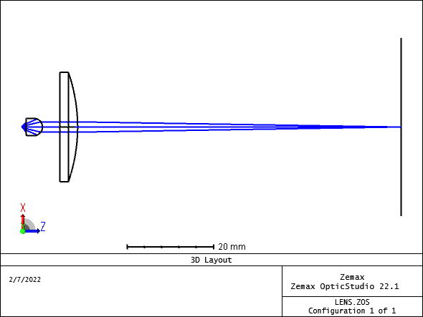
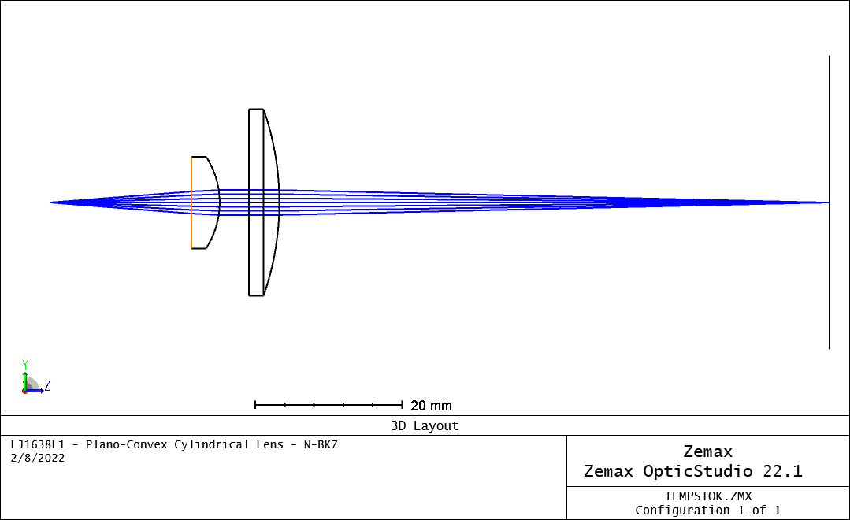
Laser Module: Optical Simulation
Osram PLPT9
Thorlabs
LJ1598L1
Thorlabs
LJ1638L1
Thorlabs
LA1608
1.21
3.81
18.28
3.89
var
4.17
67.50
Group 12
3D Printing by Selective Laser Sintering
Notes:
Zemax was used to simulate the optical system and optimize distances between lenses.
The layout is shown below with all values measured in millimeters.
The inset figure shows focusing of the fast axis and slow axis.

Slide 15
Laser Module: Housing Design
Fan
Housing must satisfy multiple constraints:
Thermal regulation of laser diode
Tight tolerance of optical elements
Lightweight
Protective
Designed in Blender and 3D printed.
4
1
2
3
View: into fan base
View: side profile
View: into optical column
View: full perspective
Group 12
3D Printing by Selective Laser Sintering
Notes:
The laser module design focused on satisfying four constraints: it must be able to thermally regulate the laser diode; it must have tight tolerances to securely and accurately mount lenses; it must be lightweight, and it must protect the lenses from dust and the surrounding printing environment. Thermal regulation was satisfied by mechanically setting the laser diode in a copper module. Tight tolerance was achieved by using a 3D printer to print multiple copies of the mount with slightly different dimensions. The lightweight and protective nature of the module came from the enclosed design of the module as well as the material used to print the module, which was PLA.

Slide 16
Material Design
4
For theoretically best sintering results:
substantial absorption around 447 nm
small range of particle sizes
spot size at least five times larger than the average particle size
Candidates:
Yellow granulated paraffin wax
Granulated sugar
Confectioner’s sugar
Raspberry tea mix
Granulated Wax
1
2
3
Raspberry Tea Mix
Pink Confectioner’s Sugar
Granulated Sugar
Group 12
3D Printing by Selective Laser Sintering
Notes:
Because SLS printing traditionally uses powders that cost hundreds of dollars, we had to find a suitable powder. Characteristics of suitable powders include absorption around the lasing wavelength of 447 nm with a small range of particle sizes. The average particle size should be four or five times smaller than our spot size. Affordable candidates for our printer included raspberry tea mix, pink confectioner’s sugar, granulated sugar, and granulated wax.

Slide 17
Mechanical Assembly
Group 12
3D Printing by Selective Laser Sintering

Slide 18
Mechanical Design Considerations
Types of Angular-to-Linear Motion Systems
Belt Drive
Lead Screw
Belt Drive
Lead Screw
Pros
High Efficiency
High Speed
Low RPM
Cons
High Cost
Complicated Implementation
Pros
High Accuracy
Low Cost
Cons
Lower Speed
Higher RPM
Group 12
3D Printing by Selective Laser Sintering

Slide 19
Lead Screw Actuator Design
Bump Switch
Pillow Bearing
Stepper Motor
Motor Bracket
Bearing Bracket
Motor Coupler
Lead Screw
Flanged Nut
Support Rods
Group 12
3D Printing by Selective Laser Sintering

Slide 20
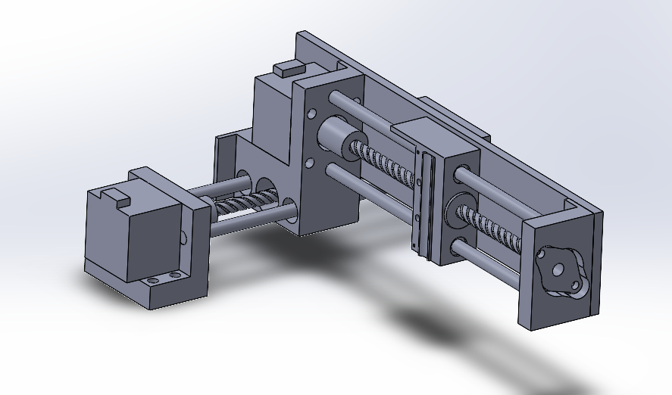
XY Track Sub-Assembly
Laser Module Base
Group 12
3D Printing by Selective Laser Sintering

Slide 21
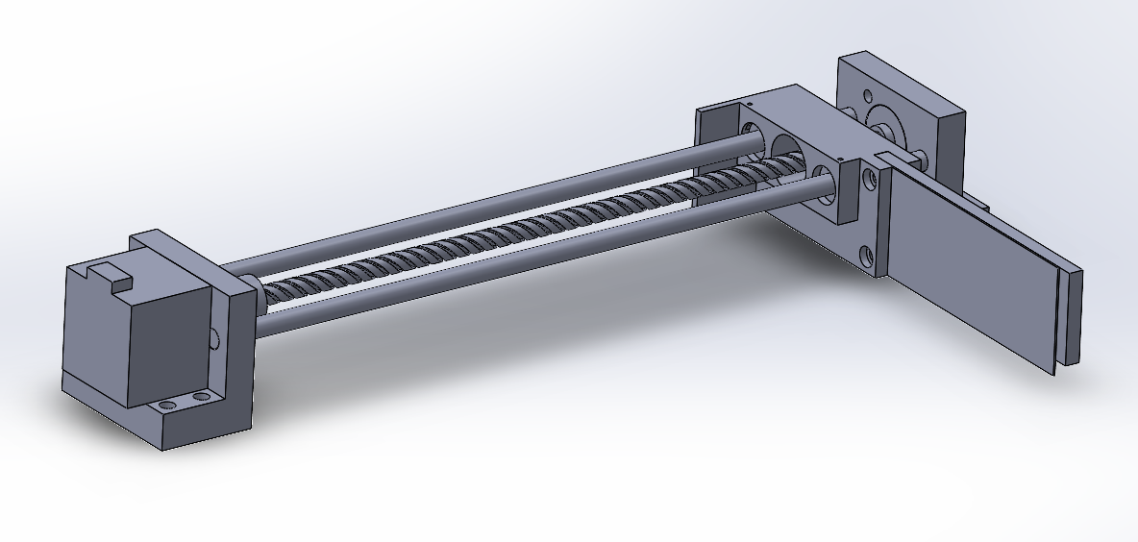
Sweeper Sub-Assembly
Sweeper Base
Sweeper Arm
Group 12
3D Printing by Selective Laser Sintering

Slide 22
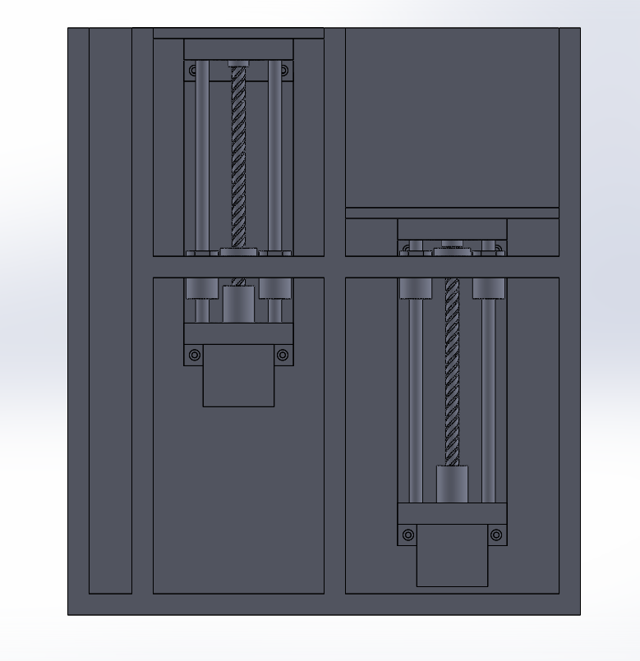
Plate Sub-Assembly
Group 12
3D Printing by Selective Laser Sintering

Slide 23
Plate Sub-Assembly
Excess Powder Reservoir
Holds excess powder accumulated after every sweep.
Group 12
3D Printing by Selective Laser Sintering

Slide 24
Plate Sub-Assembly
Build Reservoir
Holds the sintered powder and surrounding support powder
Build plate moves down after every sintered layer
Group 12
3D Printing by Selective Laser Sintering

Slide 25
Plate Sub-Assembly
Powder Reservoir
Stores powder prior to sintering.
Reservoir is larger than build reservoir to insure proper
Powder Reservoir: 5 in. x 4 in. x 4 in. = 80 in.³
Build Reservoir: 4 in. x 4 in. x 4 in. = 64 in.³
EP Reservoir: 13.25 in. x 1 in. x 4 in. = 53 in.³
Assuming 100% transfer,
EP Reservoir is 30.2% filled.
Group 12
3D Printing by Selective Laser Sintering

Slide 26
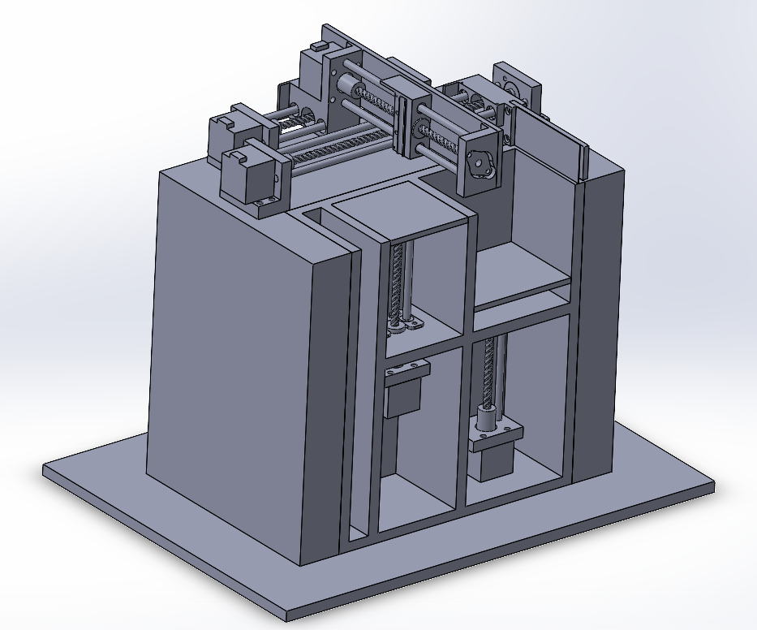
Complete Assembly with Side Panel Removed
13.75
10.25
16.05
Group 12
3D Printing by Selective Laser Sintering

Slide 27
Complete Assembly
Group 12
3D Printing by Selective Laser Sintering

Slide 28
Software Design
Group 12
3D Printing by Selective Laser Sintering

Slide 29
Initial Software Design
The original plan
G-code parser, GUI, laser controller, 2d drawing system, etc.
All top-level classes rely on other lower-level classes to implement (and abstract) functionality
Communication handled by unified serial networking protocol to ensure information safety, and proper synchronization
Group 12
3D Printing by Selective Laser Sintering

Slide 30
Software Design Considerations
Initial processor choice lacked the necessary IO for all physical components
Processes had to be split between two MCUs to account for all needed pins
Motors
Laser
Display
Sensors
Using separate processors presented many new issues
Timing/Synchronization
Communication
Resource management
Division of work
Group 12
3D Printing by Selective Laser Sintering
Notes:
“initial processor comparison discussed later”

Slide 31
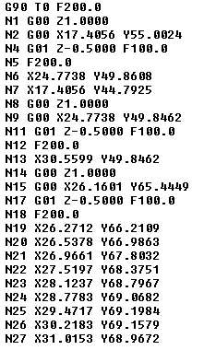
Software Design Considerations
Slicers don’t use a single standard
G-code has a variety of codes
Linear movements
Diagonal movements
Arcs
Acceleration
Bed level
Bed temperature
Hot-end temperature
Different slicers and printer capabilities mean a litany of codes that either may never be used or may not be supported.
Group 12
3D Printing by Selective Laser Sintering
Notes:
And if those issues weren’t enough, we actually found out that g-code has some redundant commands; like linear movements, diagonal movements, and arcs.
Because of that, different slicers can render the same model differently, and if we want our printer to work: we would have to support ALL of those commands in the firmware.

Slide 32
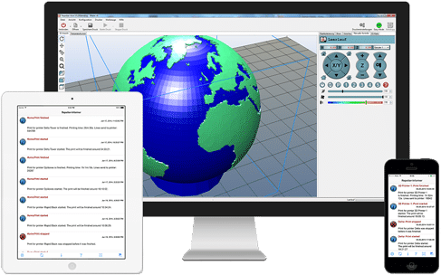
Final Software Consideration
Repetier: open-source firmware
Includes many modules working in tandem
Different layers of abstraction for different printer function
Well tested support for different hardware and software
Group 12
3D Printing by Selective Laser Sintering

Slide 33
Software Block Diagram
G-code
Coordinate Calculation
Coordinate Correction
User Interface
G-code Interpreter
Motor Profile
Settings
Motor Movement
HAL*
Computation Hardware
Physical IO
* Hardware Abstraction Layer
Group 12
3D Printing by Selective Laser Sintering

Slide 34
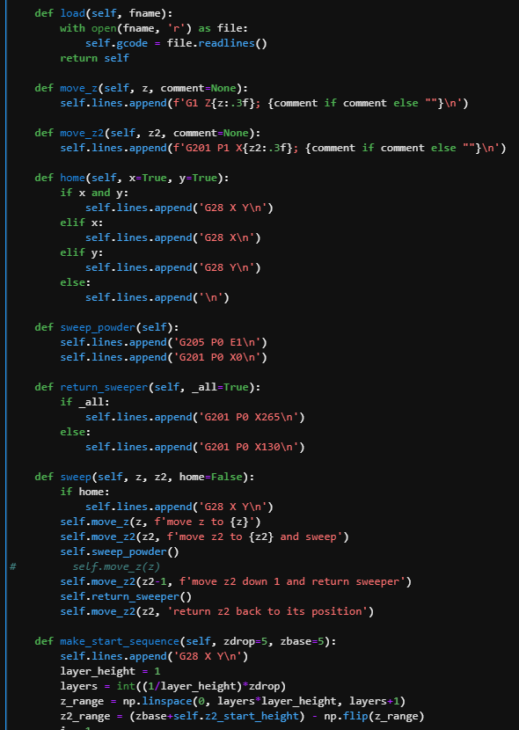
Post-Processing Script
Slicers are made for FDM 3D printers
Most 3D printers are of the FDM variety, and that is reflected in available 3D printing software.
Like the firmware, slicer was not readily compatible with SLS printing
Gcode Post-Processing
We developed a custom processing script to automatically modify gcode made for FDM printers to work with our SLS printer
Modifications include:
Adjusting laser power for print and travel movements
Adding material between layers instead of during print movements
Adjusting speed for optimal sintering
Group 12
3D Printing by Selective Laser Sintering
Notes:
Before any of that can happen though, the gcode needs to be generated, and doing that for an sls printer is not so straight forward.
In our testing, we found that most slicers are made for FDM or SLA (resin) 3d printers; this makes sense because most printers on the market use these printing methods, but it also means that like the firmware, our slicer would not be readily compatible with our printer.
To fix this, we developed a gcode post processing script to convert gcode made for fdm/sla printers to gcode that would work for our sls printer. To do this it had to make a few modifications including adjusting the laser power for print and travel movements, adding material in between layers, and adjusting the speed and power in tandem for optimal sintering.

Slide 35
Electrical Design
Group 12
3D Printing by Selective Laser Sintering

Slide 36
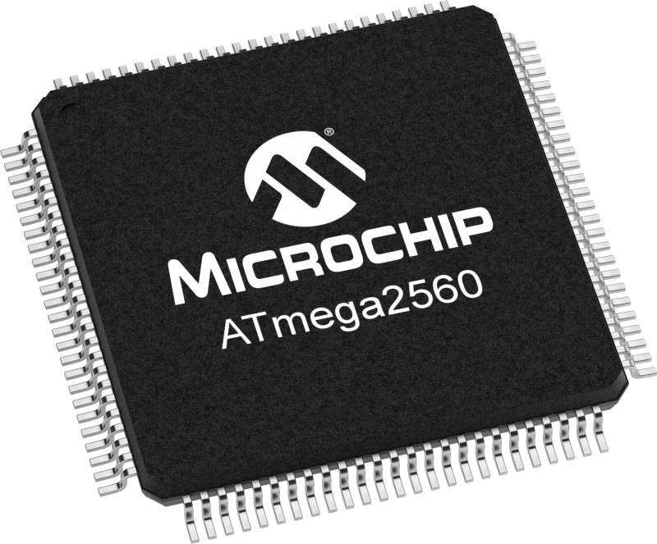
MCU
Purpose: ATmega2560 is used to control the following
5 Stepper Motor Drivers
USB communication to computer GUI
Laser Driver
External components
16MHz Crystal Oscillator
USB to UART Controller – CP2102
Micro USB Type B Port
Power on LED
Test LED
Capacitors
Resistors
Diodes
 | ATMEGA2560 | RP2040
ISA | AVR (8-bit) | ARM (32-bit)
Clock Frequency | 16 MHz | 133 MHz
Cores | 1 | 2
Storage | 256 KB (flash) + 4 KB (EEPROM) | Up to 16 MB (external flash)
Memory | 8 KB | 256 KB
Physical IO | 86 | 30
Price | $12.74 | $1.00
Availability | 09-Feb-2023* | Immediate
Group 12
3D Printing by Selective Laser Sintering

Slide 37
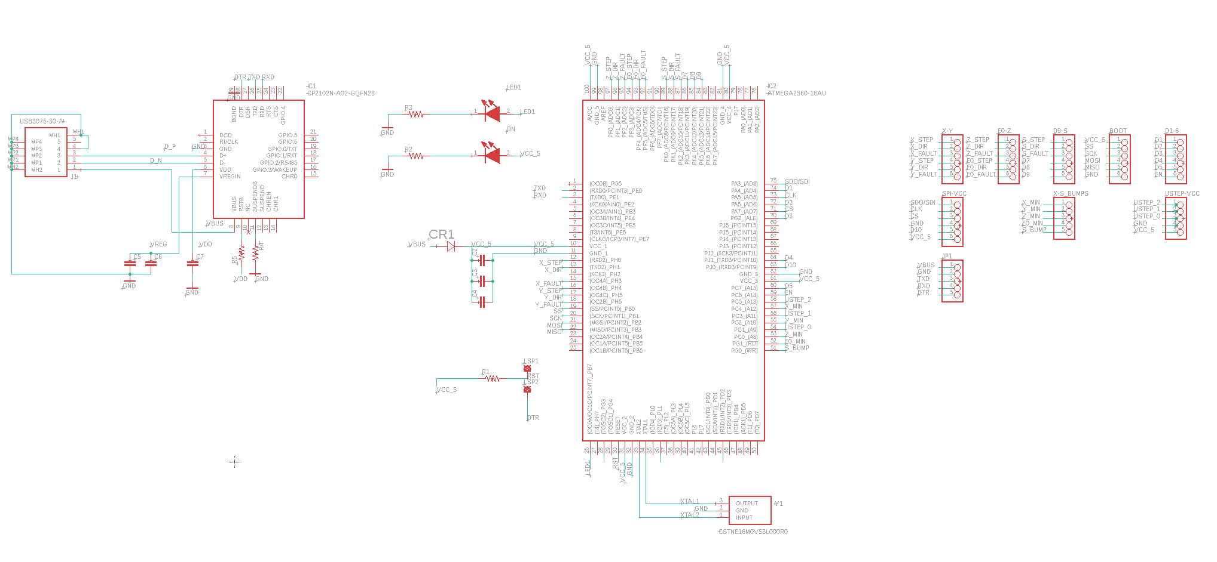
MCU Schematic
Group 12
3D Printing by Selective Laser Sintering

Slide 38
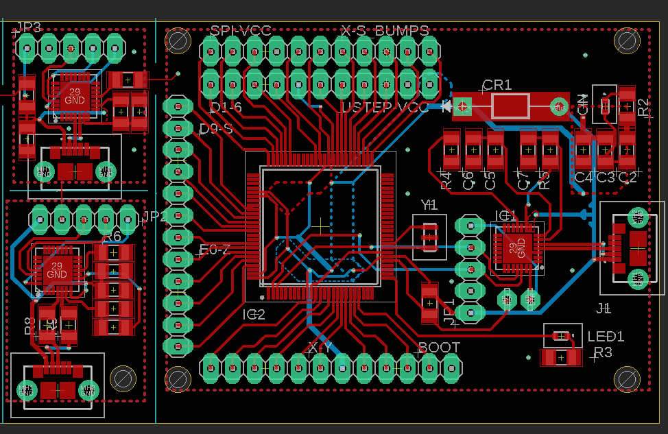
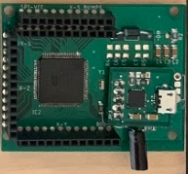
MCU PCB
Group 12
3D Printing by Selective Laser Sintering
Notes:
Real PCB and what was done to verify the PCB

Slide 39
Power Supply Module
60 Hz Transformer
Group 12
3D Printing by Selective Laser Sintering
Notes:
AC/DC Converter
Design requirements
Transformer – Bridge – Capacitor
Fuse, switch, fan
60hz transformer over flyback simplicity, availability, cost
12V – 9V Regulator (x5)
Need
Design requirements (current)
Chip selection
12V – 6V Regulator
Need
Design Requirements (current, soft start)
Chip selection
12V – 5V Regulator
Need
Design Requirements (current)
Chip selection

Slide 40
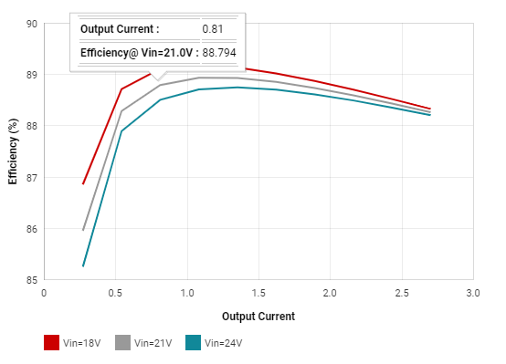
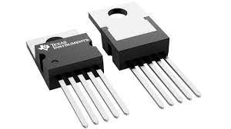
Power Supply Module
Group 12
3D Printing by Selective Laser Sintering
Notes:
AC/DC Converter
Design requirements
Transformer – Bridge – Capacitor
Fuse, switch, fan
60hz transformer over flyback simplicity, availability, cost
12V – 9V Regulator (x5)
Need
Design requirements (current)
Chip selection
12V – 6V Regulator
Need
Design Requirements (current, soft start)
Chip selection
12V – 5V Regulator
Need
Design Requirements (current)
Chip selection

Slide 41
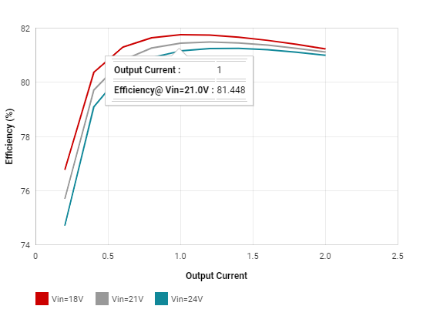
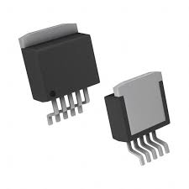
Power Supply Module
Group 12
3D Printing by Selective Laser Sintering
Notes:
AC/DC Converter
Design requirements
Transformer – Bridge – Capacitor
Fuse, switch, fan
60hz transformer over flyback simplicity, availability, cost
12V – 9V Regulator (x5)
Need
Design requirements (current)
Chip selection
12V – 6V Regulator
Need
Design Requirements (current, soft start)
Chip selection
12V – 5V Regulator
Need
Design Requirements (current)
Chip selection

Slide 42
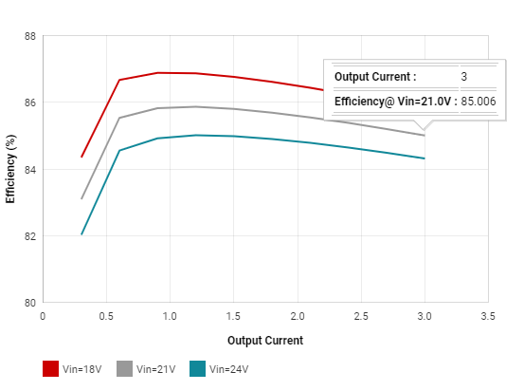
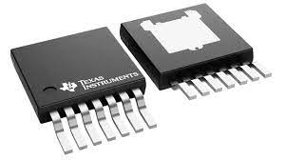
Power Supply Module
Group 12
3D Printing by Selective Laser Sintering
Notes:
AC/DC Converter
Design requirements
Transformer – Bridge – Capacitor
Fuse, switch, fan
60hz transformer over flyback simplicity, availability, cost
12V – 9V Regulator (x5)
Need
Design requirements (current)
Chip selection
12V – 6V Regulator
Need
Design Requirements (current, soft start)
Chip selection
12V – 5V Regulator
Need
Design Requirements (current)
Chip selection

Slide 43
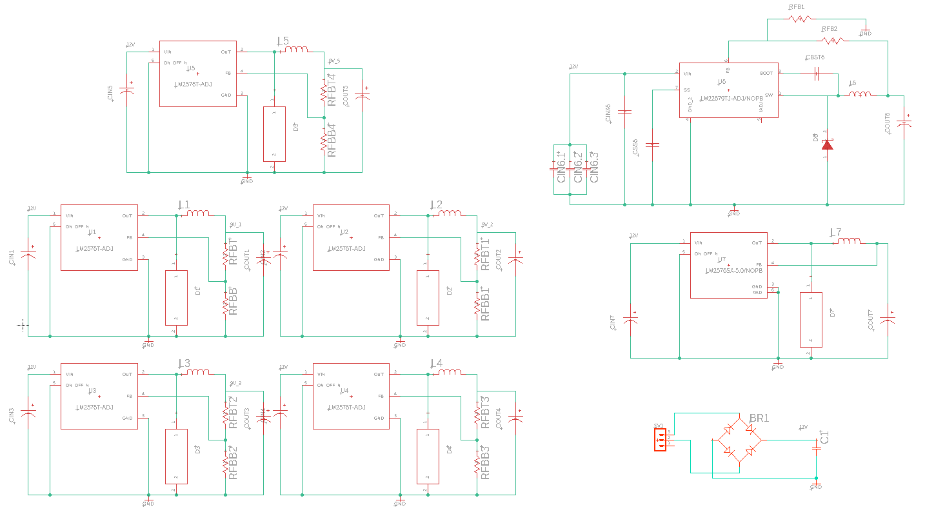
Power Supply Module Schematic
Group 12
3D Printing by Selective Laser Sintering

Slide 44
Power Supply Module Schematic
Group 12
3D Printing by Selective Laser Sintering

Slide 45
Power Supply Module Schematic
Group 12
3D Printing by Selective Laser Sintering

Slide 46
Power Supply Module Schematic
Group 12
3D Printing by Selective Laser Sintering

Slide 47
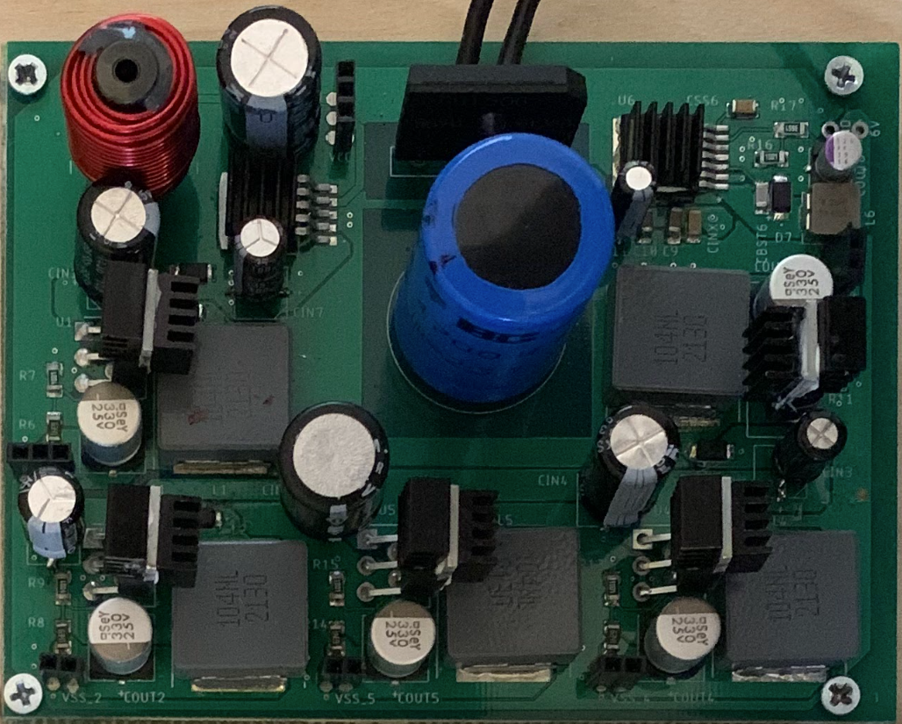
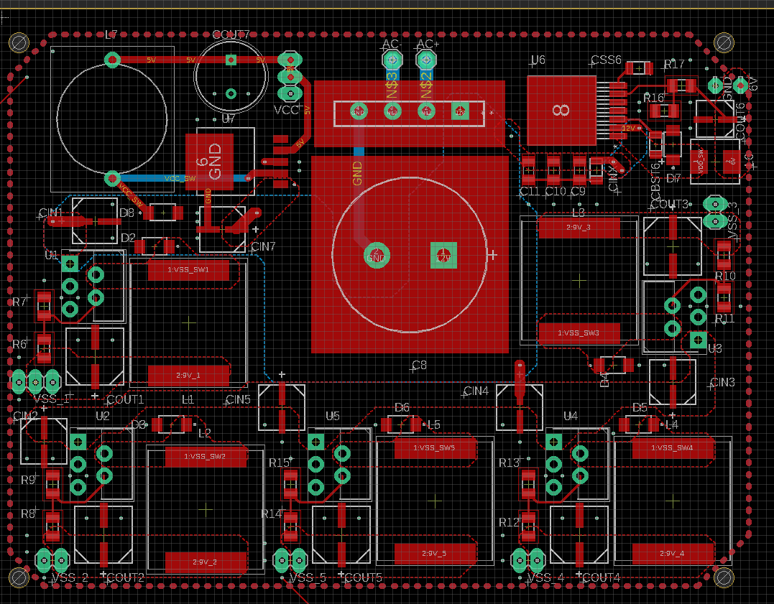
Power Supply Module PCB
Group 12
3D Printing by Selective Laser Sintering

Slide 48
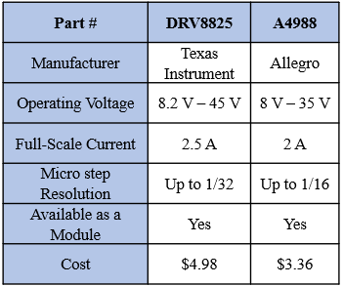
Stepper Motor Driver
Purpose: Controls precise stepper motor movement dependent on signals from MCU.
DRV8825 Size Comparison
Group 12
3D Printing by Selective Laser Sintering

Slide 49
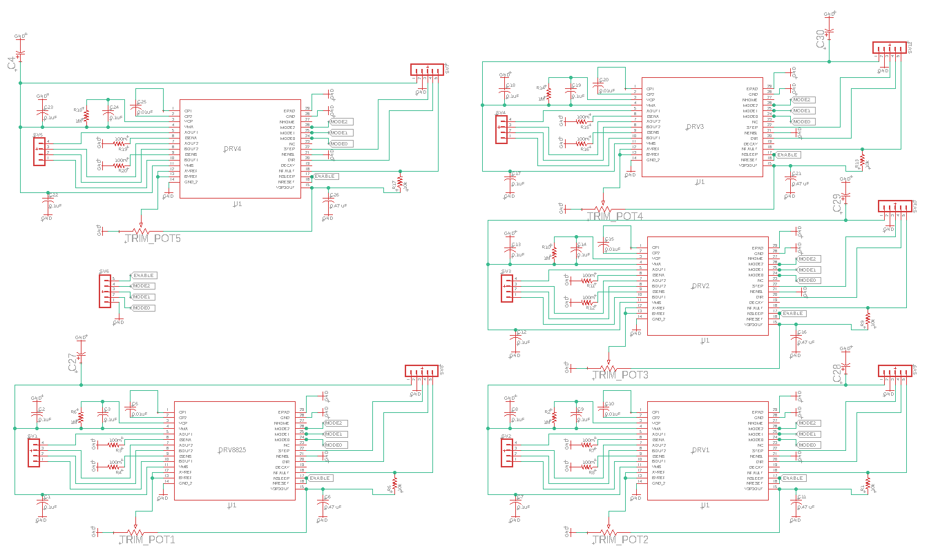
Stepper Motor Driver Schematic
Group 12
3D Printing by Selective Laser Sintering

Slide 50
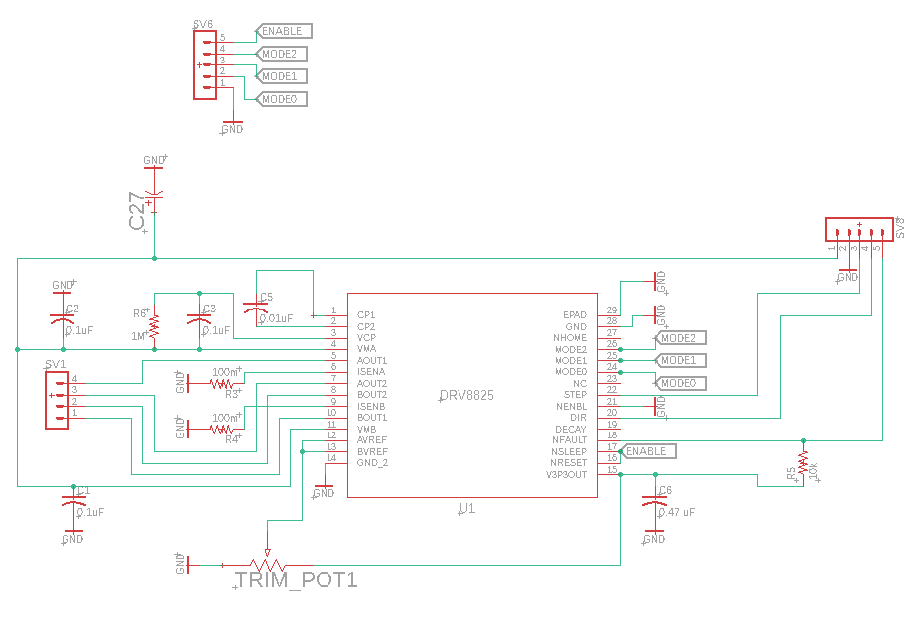
Stepper Motor Driver Schematic
Micro-step Control and Enable Bits
Pin 1 = 9 V
Pin 2 = GND
Pin 3 = Step
Pin 4 = Dir
Pin 5 = nFault
Group 12
3D Printing by Selective Laser Sintering

Slide 51
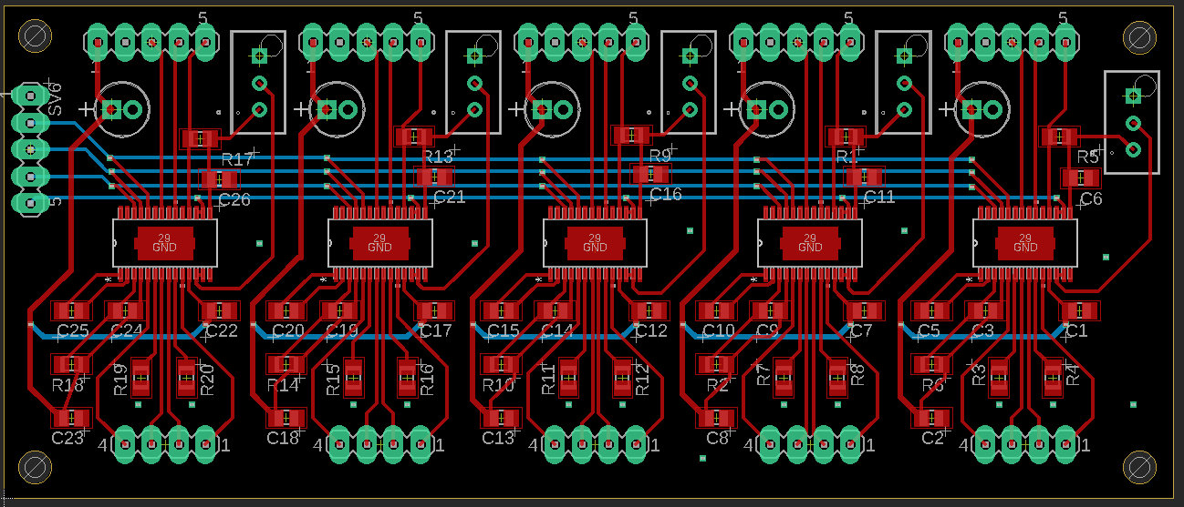
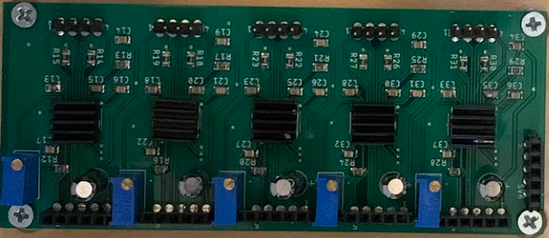
Stepper Motor Driver PCB
Verification:
Adjusted each trim potentiometers until the reference voltage was 0.75 V.
Each driver was tested to ensure proper stepper motor driver functionality.
Group 12
3D Printing by Selective Laser Sintering
Notes:
The PCB layout for the stepper motor driver is shown in the top left. The final stepper motor driver PCB is shown in the bottom left. In order to verify the functionality of the PCB, we ensured all drivers were capable of properly driving a stepper motor. The first step was setting the reference voltage for every driver to 0.75 V. Next, the enable pin was set to logic high and motors were connected. A simple script was used to turn the motors clockwise and counter-clockwise. All motor drivers on the PCB were able to successfully control a stepper motor.

Slide 52
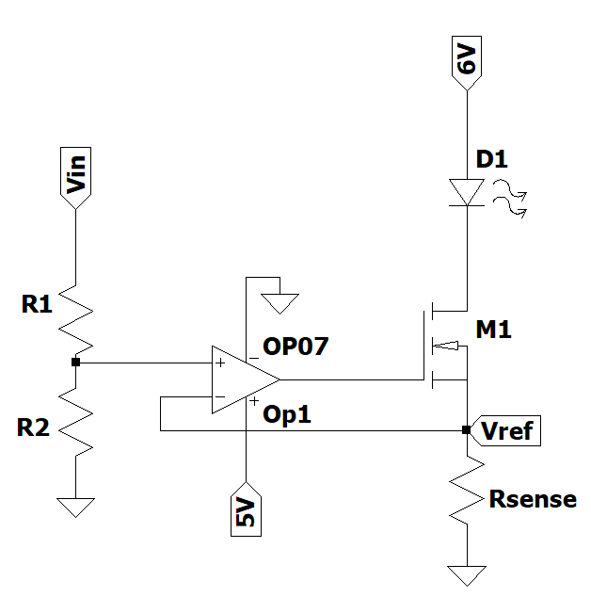
Laser Diode Driver
Purpose: Controls the laser output power by adjusting the constant current to a laser diode.
6 Volt supply voltage with 25ms soft start
3 Amp maximum current
Adjustable current using digital potentiometer
Digital potentiometer controlled by MCU using SPI communication protocol
Digital Potentiometer
I_{D} = V_{ref}/R_{sense}
Group 12
3D Printing by Selective Laser Sintering
Notes:
Laser Diode Driver
Digital Potentiometer

Slide 53
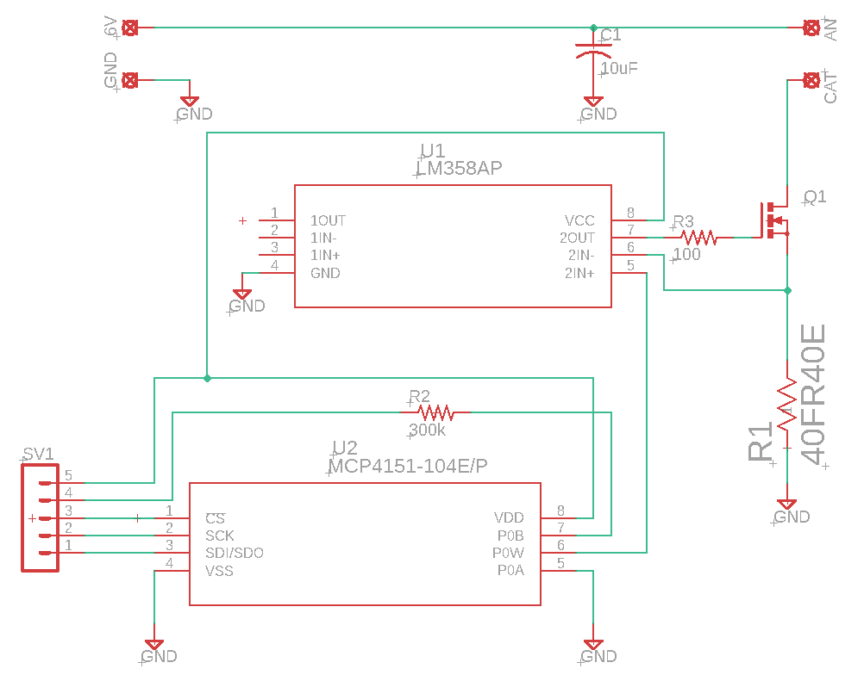
Laser Diode Driver Schematic
Group 12
3D Printing by Selective Laser Sintering

Slide 54
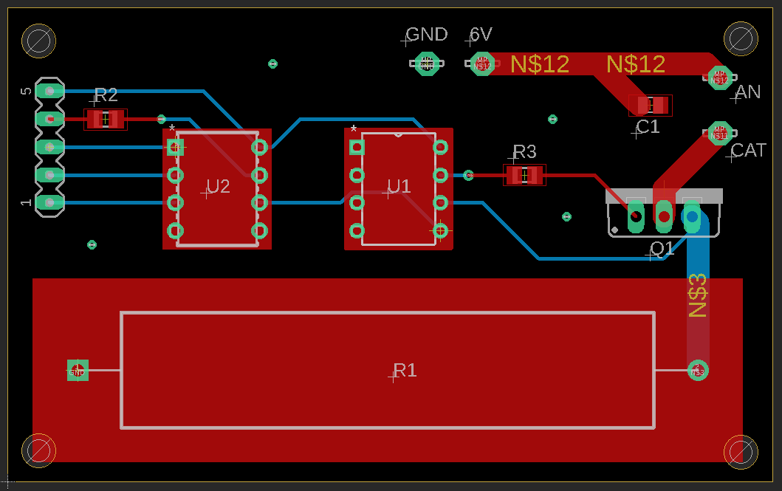
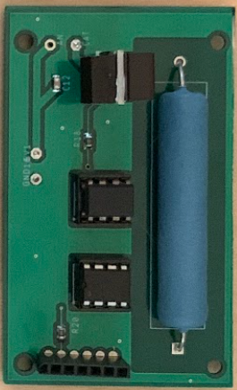
Laser Diode Driver PCB
Verification:
Measured current values at different digital potentiometer settings.
Ensured a constant delivery of current.
Digital Potentiometer Value (0-255) | Measured Output Current (A)
5 | 3.029
51 | 2.259
102 | 1.671
153 | 1.095
204 | 0.579
255 | 0
Group 12
3D Printing by Selective Laser Sintering
Notes:
The PCB layout for the laser driver is shown in the top left. The final laser driver PCB is shown in the bottom left. In order to verify the functionality of the laser driver, we ensured the circuit was capable of deliver a constant current at different potentiometer values. Potentiometer values were sent via SPI communication and the current was recorded for each set value. The results of the laser driver testing is shown in the table in the bottom right. From the table, we find that we were able to successfully control the current from 0 – 3 Amps as designed.

Slide 55
Encountering a Major Problem
Problem:
The laser diode broke on April 8th, 2022, before critical sintering testing.
Mechanical stress cause anode to fall off
Solution:
Order a laser module, along with a 12 V power supply, to ensure sintering testing before project submittal.
In parallel, a new laser diode was ordered to complete designed laser module.
Group 12
3D Printing by Selective Laser Sintering
Notes:
One major hurdle encountered during the development of our printer was the failure of our laser diode. Right before the critical testing period, the anode of the diode popped off. This was most likely caused by mechanical stress which we fixed in later designs of the copper housing. Unfortunately, we had to wait a week for a new laser diode to arrive, so in this time we managed to buy a laser module with similar characteristics to begin testing. The designed laser module was not able to be thoroughly tested with sintering as a result.

Slide 56
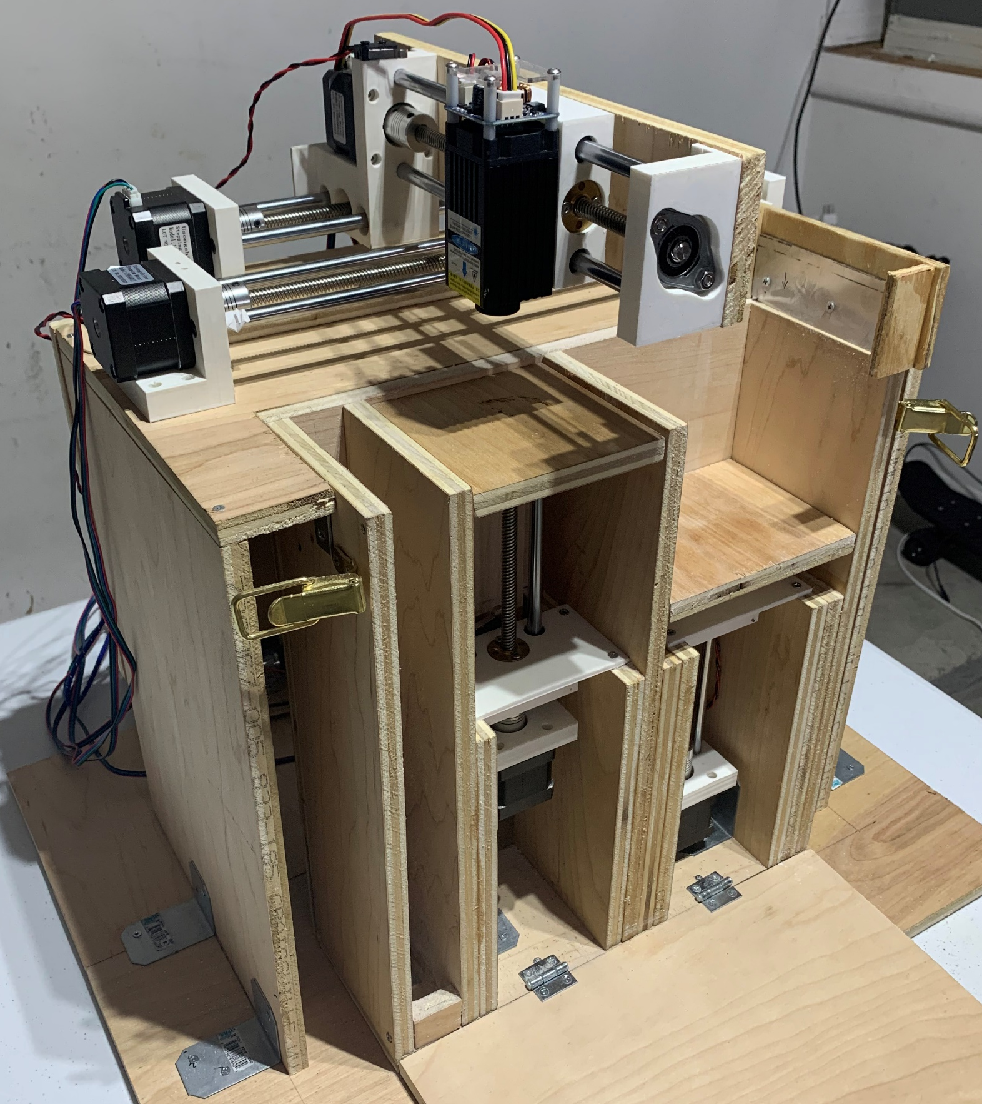
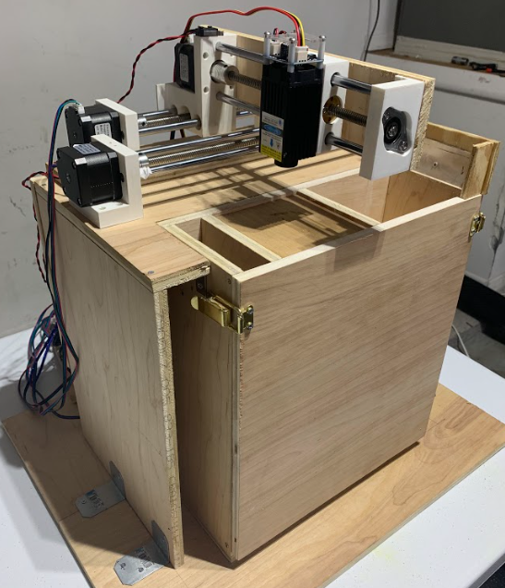
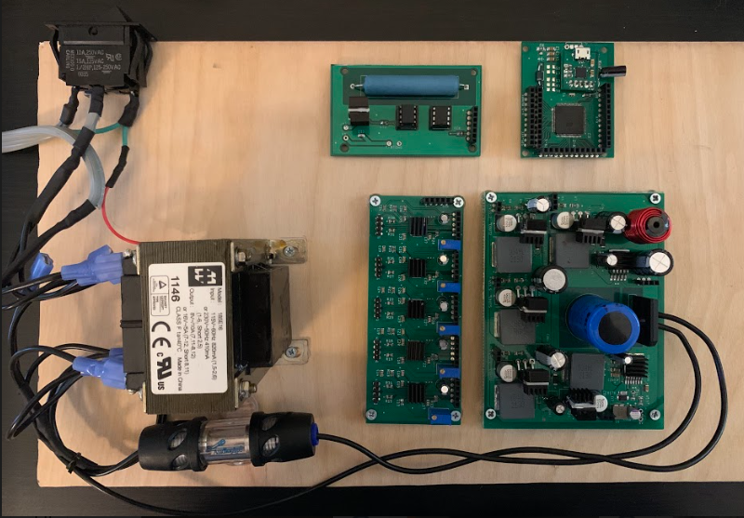
Final Printer Prototype
SLS 3D Printer Final Prototype
Used for multiple tests
5 axis movements
Gcode parsing
Distance consistency
“Dry” printing
Sintering
Printing
Multiple successful prints
Stress testing
Group 12
3D Printing by Selective Laser Sintering
Notes:
Overall, the printer came out quite well. Here we can see the completed prototype which was used for various phases of testing up to and including multiple successful prints.
We were able to test all the needed features of the printer like movement on all 5 axes, gcode parsing, and the consistency of travel distances before starting a “dry” (powder free) print, testing sintering capabilities, and eventually printing.
We have completed multiple successful (and tasty) prints including our smiley model, and UCF’s pegasis logo which can be seen in the top left of this slide.

Slide 57
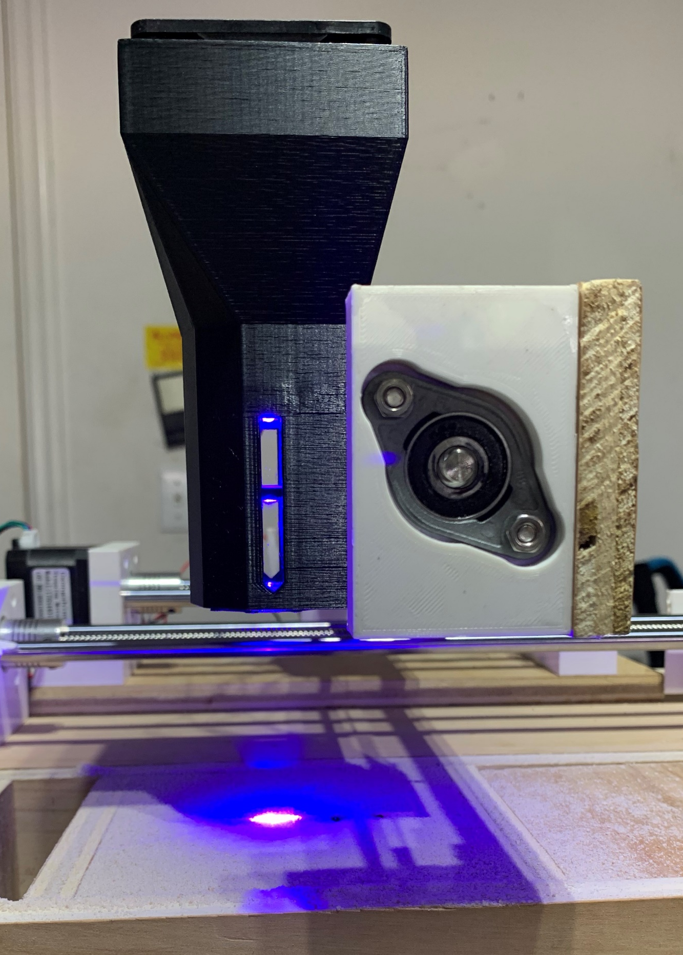
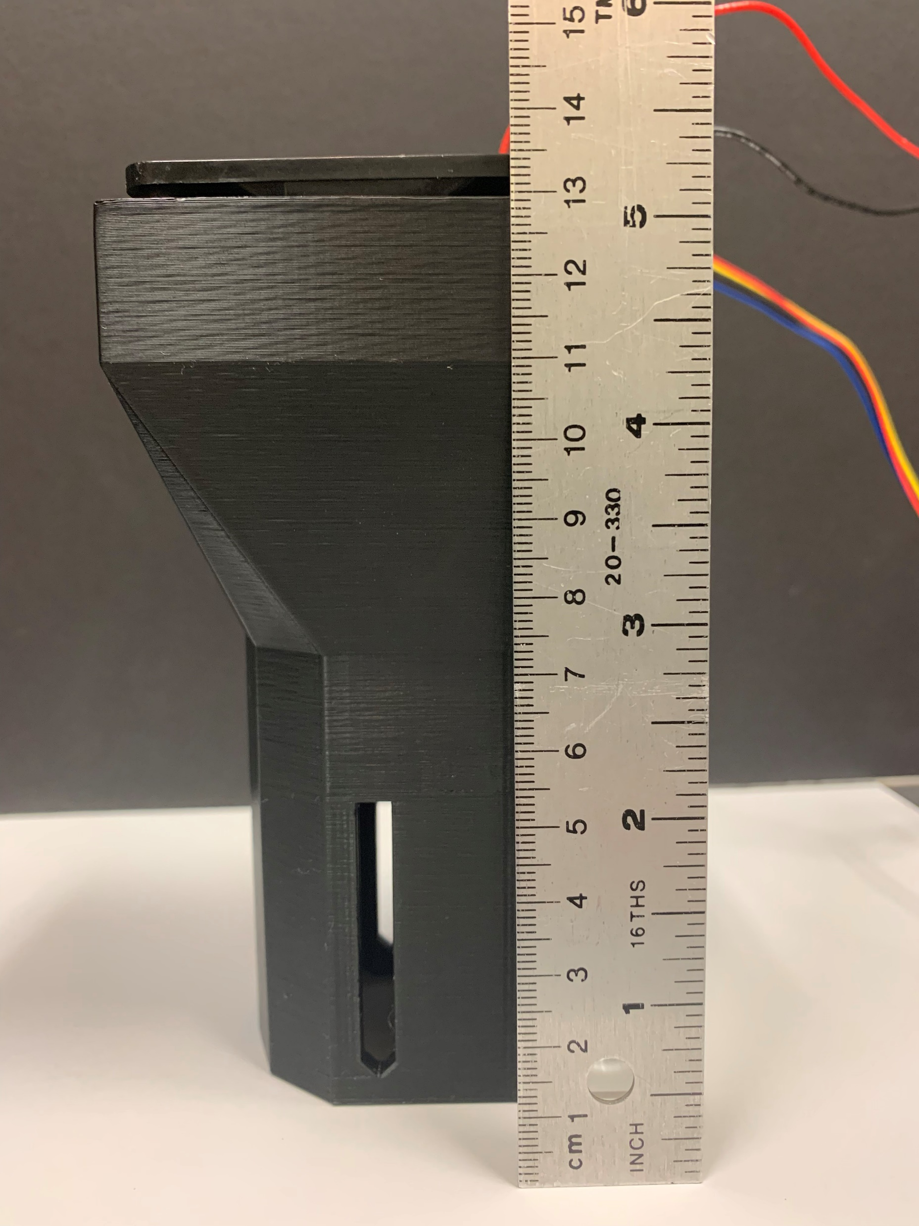
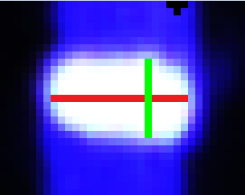
Final Laser Module Prototype
Cylindrical Lens Mount 1
Mounts and module printed with a Prusa iMKS3+ 3D printer
Layer height: 0.2 mm
Spot size: 68 μm x 39 μm
Shape correction: Δ 5.44 to Δ 1.74
Difficulties: layer height limited longitudinal optical alignment to 200 μm
4
7
Cylindrical Lens Mount 2
5
6
Spherical Lens Mount 3
19 pixels = 68 μm
11 pixels = 39 μm
Group 12
3D Printing by Selective Laser Sintering
Notes:
The final laser module consists of 3D-printed lens mounts within a 3D printed enclosure. The lens mounts slide along grooves inside the module. A fan sits atop the module and cools the copper cylinder immediately below with the help of channels to direct airflow. Overall, the performance of the module was as expected. The smallest spot size achieved was 68 by 39 microns with a shape correction of 68%.

Slide 58
Powder Testing
Multiple materials tested
Confectioners sugar (dyed for better light absorption)
Granulated sugar
Granulated paraffin wax
Iced tea mix
Multiple metrics tested
Surface consistency (when spread by printer)
Ease of sintering
 | Surface Consistency | Ease of Sintering
Confectioners Sugar | Poor | Decent
Granulated Sugar | Good | Poor
Granulated Wax | Decent | Decent
Iced Tea Mix | Good | Good
Group 12
3D Printing by Selective Laser Sintering
Notes:
In order to determine the best material for our proof of concept, a variety were tested based on several important metrics.
To keep prices down, we chose to use readily available materials like sugar, wax, and iced tea mix. We also used multiple tests including the material grain size, the surface consistency when we spread it with the printers sweeper mechanism, and how well it could be sintered together.
After all our testing, we concluded that Iced tea mix was the best material for our prototype; it had enough small particles that we didn’t need to increase our laser spot size, the surface consistency was good when a new layer was swept across, and coloring and high sugar content meant that it absorbed light and sintered quite well.

Slide 59
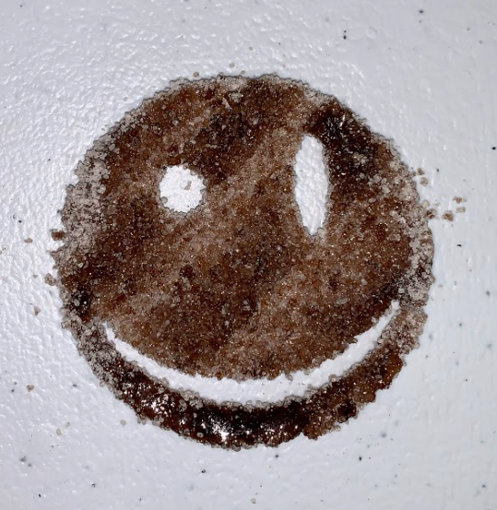
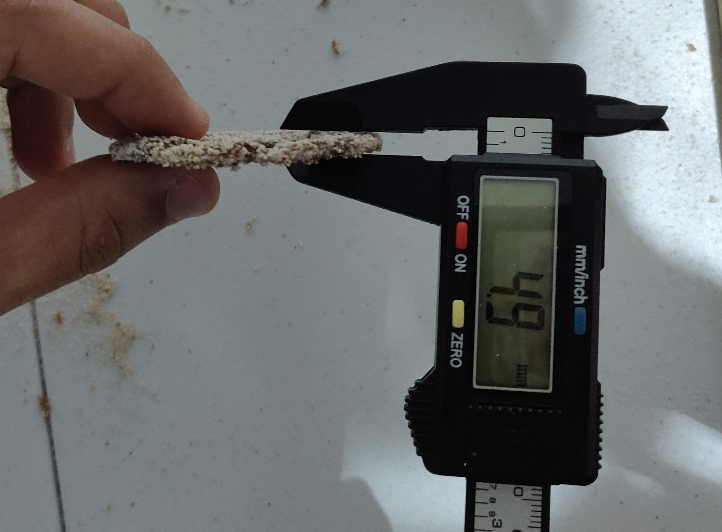
‘Smiley’ Printer Results
(a)
(b)
(c)
Group 12
3D Printing by Selective Laser Sintering
Notes:
Testing of the sintering capabilities of our powder was performed with a handheld 1W blue laser pointer.
The material composition was tested for sintering capabilities as a proof of concept.
In the figures, beading of the sintered material can be seen.
This occurs if the process parameters are not optimized.
These parameters will be optimized through testing in the upcoming months.

Slide 60
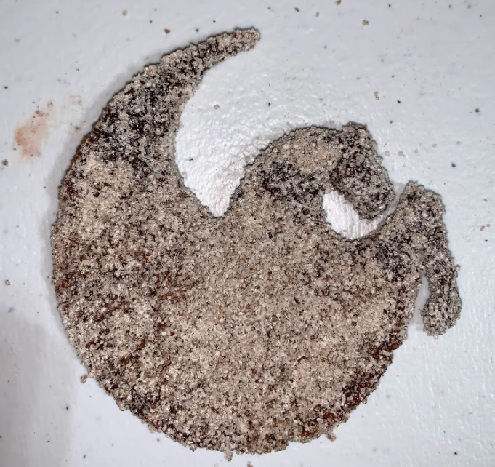
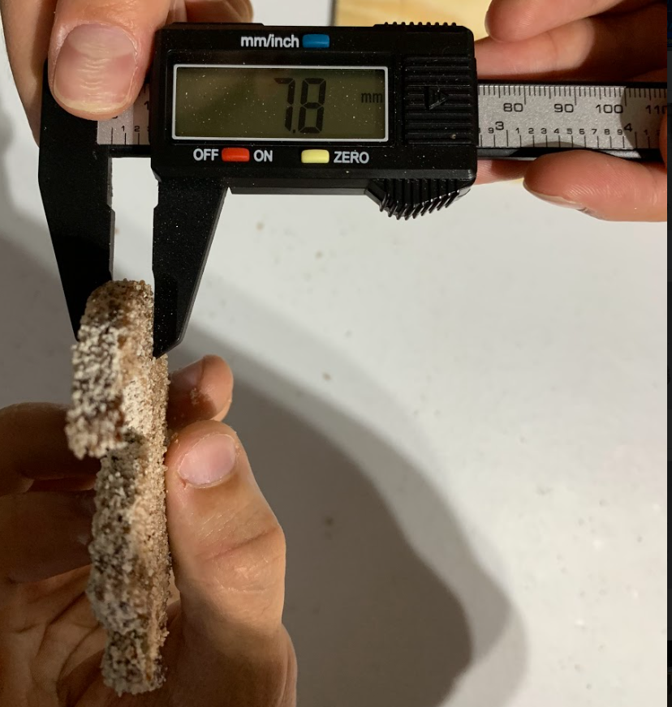
‘Pegasus’ Printer Results
(a)
(b)
(c)
Group 12
3D Printing by Selective Laser Sintering
Notes:
Testing of the sintering capabilities of our powder was performed with a handheld 1W blue laser pointer.
The material composition was tested for sintering capabilities as a proof of concept.
In the figures, beading of the sintered material can be seen.
This occurs if the process parameters are not optimized.
These parameters will be optimized through testing in the upcoming months.

Slide 61
Problems with Current Prototype
Current X-Y track design causes excessive jerk at higher speeds
Very fine powder, such as confectioner’s sugar, results in uneven powder delivery to the build area
Current firmware uses a set laser power which causes some areas of the print to melt and other areas to sinter
Sintering
Melting
Confectioner’s Sugar Powder Delivery
Group 12
3D Printing by Selective Laser Sintering
Notes:
After extensive testing with the printer, we noticed some issues with our design. The first problem was the XY track. At high scanning speeds, the weight of the laser module caused excessive jerk which ended in unsuccessful prints. The second problem was powder delivery with fine powders. When testing powder delivery with fine powders, we were not able to achieve a smooth surface in the build area which would cause uneven or unsuccessful prints. An example of this is shown in the bottom left. The third problem was sintering capability in the firmware. Since we used a set laser power throughout the whole print, some areas of the print would melt while the reset would properly sinter. Notice the face and arm of the UCF Pegasus is melted as the rest is properly sintered

Slide 62
Future Improvements to Prototype
Mechanical Design
Interdisciplinary collaboration
Metal structural components (for a lighter and more rigid structure)
Tighter tolerances
A powder compacting mechanism
Electrical Design
Flyback transformer power supply
Motherboard Daughterboard configuration
Software Design
Integrate calibration functionality in firmware instead of Gcode
Integrate layer change sequence in firmware instead of Gcode
Streamline Gcode generation pipeline
Group 12
3D Printing by Selective Laser Sintering
Notes:
While our prototype printer is functional, there are still plenty of improvements that can be made in the future.
From a Mechanical design perspective, the biggest improvement would probably be more interdisciplinary collaboration; this project was designed and implemented without any mechanical engineering students, and while it ultimately works within the set requirements, the structure we designed was the first (and only part) to fail when stress testing beyond spec. Additionally, metal components could be used for a lighter and mor rigid structure with tighter tolerances, and a powder compacting mechanism would be a good addition to help with materials that have poor surface consistency.
For the electrical design, we chose to use a 60Hz transformer (@85% efficiency) because it was readily available, but a redesign of our power module to integrate a flyback transformer would be more efficient, and lighter.
We also chose to modularize our electrical design into several components for improved testing, troubleshooting, and iteration, but that also has the drawback of all our components needing to be wired together. In the future, a motherboard can be made to accept these modules as daughterboards and route all power and signals appropriately with ought needing many wires.
The software and firmware could also be further improved by integrating the calibration and layer change sequences into the firmware instead of implementing them using gcode. Additionally, the gcode generation pipeline could be streamlined by including the post-processing script as an addon in the slicer.

Slide 63
Budget and Finance
Sub Assembly | Cost
Mechanical Assembly | $182.67
Laser Module | $214.74
Power Components | $104.98
Computing Components | $26.96
Motor Driver Components | $64.35
Laser Driver Components | $6.73
PCB Cost | $68.97
Back-up Laser Module & Power Supply | $65.98
Actual Total | $735.38
Projected Total | $600
Group 12
3D Printing by Selective Laser Sintering

Slide 64
Thank You
Group 12
3D Printing by Selective Laser Sintering
Notes:
While our prototype printer is functional, there are still plenty of improvements that can be made in the future.
From a Mechanical design perspective, the biggest improvement would probably be more interdisciplinary collaboration; this project was designed and implemented without any mechanical engineering students, and while it ultimately works within the set requirements, the structure we designed was the first (and only part) to fail when stress testing beyond spec. Additionally, metal components could be used for a lighter and mor rigid structure with tighter tolerances, and a powder compacting mechanism would be a good addition to help with materials that have poor surface consistency.
For the electrical design, we chose to use a 60Hz transformer (@85% efficiency) because it was readily available, but a redesign of our power module to integrate a flyback transformer would be more efficient, and lighter.
We also chose to modularize our electrical design into several components for improved testing, troubleshooting, and iteration, but that also has the drawback of all our components needing to be wired together. In the future, a motherboard can be made to accept these modules as daughterboards and route all power and signals appropriately with ought needing many wires.
The software and firmware could also be further improved by integrating the calibration and layer change sequences into the firmware instead of implementing them using gcode. Additionally, the gcode generation pipeline could be streamlined by including the post-processing script as an addon in the slicer.

